Slide 1

INTRODUCTION
Hello and welcome. In this presentation, I will take you through our company's sales performance for the years 2010 and 2011.
I appreciate TATA Group for the opportunity you gave me to dive into this data to gain insightful information about the store's performance.
Thanks to CEO and CMO for the questions you asked to me and provided a general direction for the kind of insights you are looking to get from this analysis.

Slide 2
THOUGHT PROCESS
I assure you that I took all the necessary steps to ensure that this analysis is accurate and correct.
I cleaned up the data you provided by removing all the negative values in the unit price and quantity columns and also filtered the data as required for all the visualizations.

Slide 3
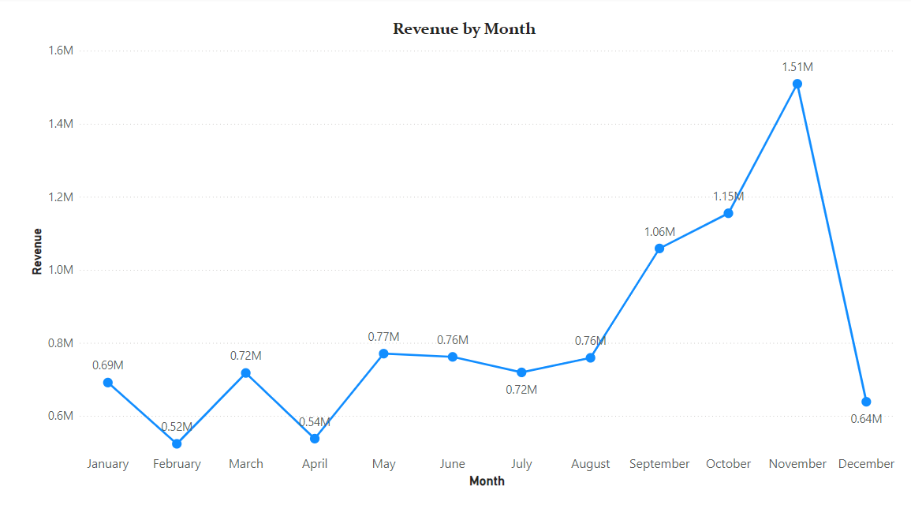
The first 8 months had stable monthly revenues with an average of $685,000.
We had a significant increase in revenue from September with the revenue peaking at $1.51 Million in November and an average of 21.18% increase in revenue from August to November.
The revenue trend from August to December demonstrates how seasonality affects retail store sales.

Slide 4
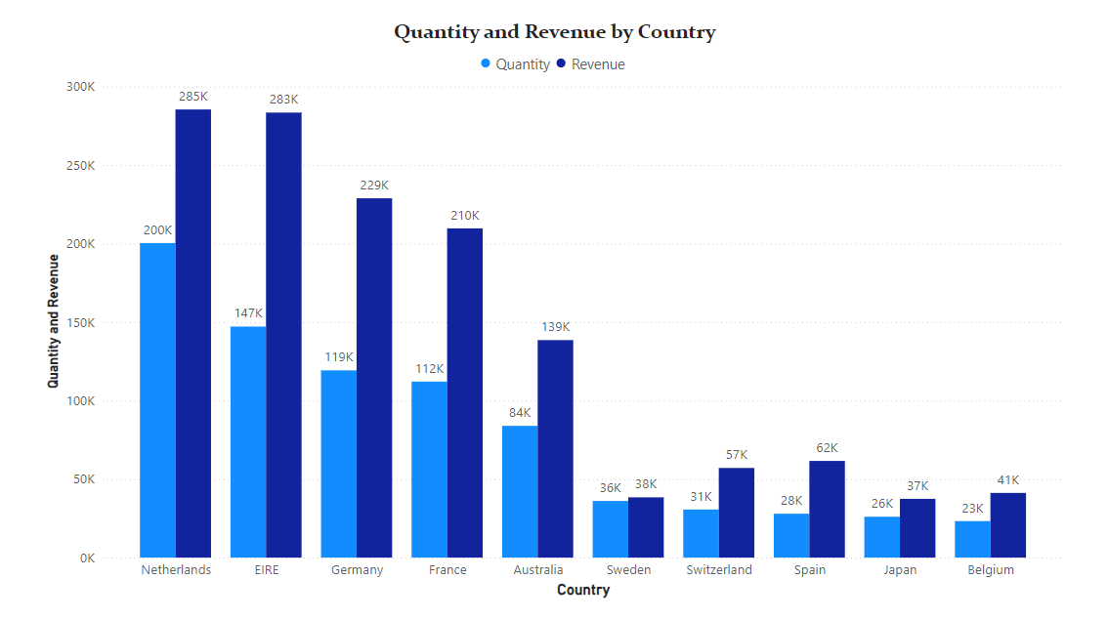
This chart represents the top 10 countries in revenue and the quantities bought in these countries except The United Kingdom.
There is no major difference between the revenue and the quantity of goods sold in these countries, showing a high purchasing power in these countries.
These countries represent regions with the highest potential to generate more revenue that management needs to focus more on in terms of marketing strategies.

Slide 5
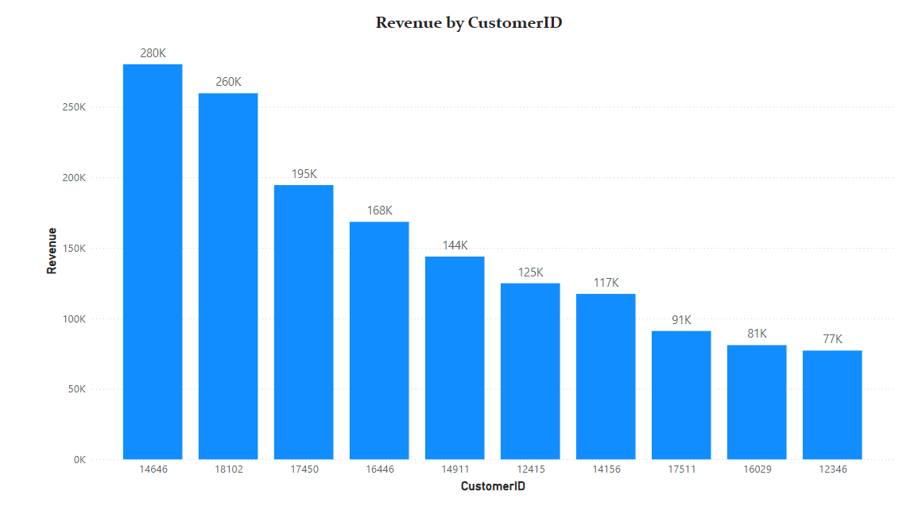
The chart shows that there is no major difference between the top 10 customers in terms of revenue generated.
The average difference in revenue between the top 10 customers is 15.8%.
The company can aim to strengthen the relationship with these customers to increase customer loyalty and retention, and ultimately drive more sales and revenue for the company.

Slide 6
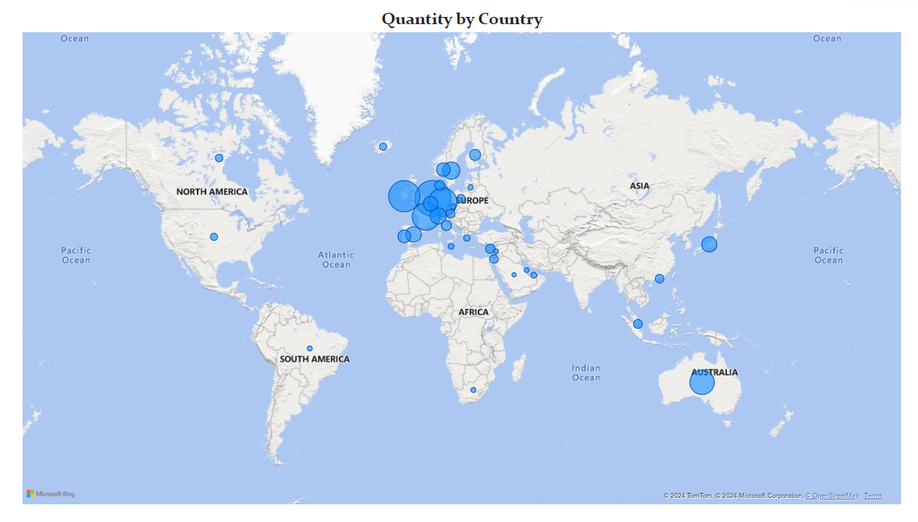
The map chart concludes by comparing the places that have produced the greatest revenue to those that have not.
The map also reveals that the majority of sales occur only in the European zone, with only a small number in the American region.
Along with Russia, there is no market for the items in Africa or Asia.
The company can concentrate on the European market more and dive deeper into countries in the region to come up with strategies that will maximize sales from each country in the region alongside Australia and Japan.

Slide 7
Recommendations
The company should come up with strategies that aim at stocking and advertising seasonal products to maximize sales when the demand for these goods goes up.
The company should do a deeper analysis of products that are usually in high demand during low-sales months to come up with strategies for marketing these products.
A deeper dive into the type of products and the revenue generated from these products for each region would be key in guiding region- specific marketing strategies.
The company should consider incentivizing top revenue-generating customers to strengthen the relationship with these customers.
The European Market has more potential for growth and the company should aim at strategies that will increase its market positioning in the region.

Slide 8
THANK YOU

